Slide 1
MACHINE LEARNING
SENTINELFLOW
DDoS Attack Detection Using
LSTM & Autoencoder-Based Anomaly Detection
PROJECT PRESENTATION
Presented by: V. Rohith — 2520090029
B. Dharshan — 2520090088
Guide: [Supervisor name] • [Department / College]
Academic year: [20XX–20XX]
CICDDoS2019 • 68 FEATURES
SENTINELFLOW • DDoS ATTACK DETECTION
01

Slide 2
Project at a glance
A machine-learning workflow for flow-level DDoS screening and anomaly detection.
INPUT
PREPARE
ANALYZE
OUTPUT
CSV of network-flow records
68 trained numeric features
Column validation, numeric cleanup,
missing-value handling, scaling
Logistic Regression • LSTM
Autoencoder
Predictions, risk indicators,
summary and result views
Design principle
Use complementary model perspectives: supervised flow classification, sequence-based classification, and reconstruction-error anomaly detection. The models are reported separately so their outputs can be interpreted rather than hidden inside one score.
Scope: a project prototype for offline CSV analysis—not a replacement for production network controls.
SENTINELFLOW • DDoS ATTACK DETECTION
02

Slide 3
Introduction
Why DDoS detection matters for network availability.
THE THREAT
THE CHALLENGE
THE PROJECT IDEA
Distributed Denial-of-Service attacks flood a target with traffic or requests, consuming bandwidth, connection capacity, or application resources.
Traffic can be high-volume, fast-changing, and mixed with legitimate activity. Static rules may miss unfamiliar patterns or generate noisy alerts.
Analyze structured flow features with multiple ML approaches and expose the results through a CSV-upload web interface.
Key goal: turn raw flow records into understandable detection signals.
SENTINELFLOW • DDoS ATTACK DETECTION
03

Slide 4
Problem statement
The project addresses the gap between raw flow data and actionable screening.
• Large CSVs contain many numerical traffic descriptors that are difficult to review manually.
• A single decision method may not capture both known attack patterns and unusual behavior.
• Sequence context can matter when related flows occur over time.
• Model outputs need to be accessible through a clear, repeatable interface.
WHO BENEFITS?
Students and researchers evaluating detection methods; network/security analysts using offline flow exports; teams prototyping a monitoring workflow.
Problem framing: this is a detection-support prototype, not an autonomous mitigation system.
SENTINELFLOW • DDoS ATTACK DETECTION
04

Slide 5
Motivation
Why combine several model perspectives?
INTERPRETABLE BASELINE
TEMPORAL CONTEXT
NOVELTY SIGNAL
Logistic Regression provides a supervised, per-flow baseline with an attack probability.
LSTM evaluates windows of 8 flows, allowing the model to use ordered sequence patterns.
An Autoencoder measures reconstruction error; high error can indicate records unlike its learned representation.
The combination supports comparison and investigation; it does not automatically guarantee higher accuracy.
SENTINELFLOW • DDoS ATTACK DETECTION
05

Slide 6
Objectives
Project objectives and measurable implementation goals.
• Build a CSV-based interface for submitting network-flow records.
• Validate the required 68 numeric model features before inference.
• Apply the training-compatible scaler and preprocessing rules.
• Generate outputs using Logistic Regression, LSTM, and Autoencoder models when artifacts are available.
• Present results in a way that supports inspection, comparison, and future evaluation.
SENTINELFLOW • DDoS ATTACK DETECTION
06

Slide 7
Existing approach vs proposed system
Positioning of the project workflow.
MANUAL / SINGLE-METHOD REVIEW
PROPOSED SENTINELFLOW
• Manual inspection is slow for large flow tables
• Fixed rules can be brittle as traffic changes
• One model gives only one view of risk
• Results may be hard to reproduce across CSV files
• Repeatable CSV validation and preprocessing
• Three model perspectives in one workflow
• Sequence-aware LSTM inference
• Web-based result presentation for uploaded data
These are conceptual comparisons; no benchmark superiority is claimed without measured experiments.
SENTINELFLOW • DDoS ATTACK DETECTION
07

Slide 8
System architecture
From uploaded CSV to model outputs.
01
02
03
04
05
06
CSV upload
Validate
68 features
Clean + scale
Three model
paths
Aggregate
summaries
Web results
Model paths
Logistic Regression
LSTM
Autoencoder
Per-flow probability and class
8-flow sequence probability
Reconstruction error vs threshold
SENTINELFLOW • DDoS ATTACK DETECTION
08

Slide 9
Methodology / workflow
The inference path implemented in the backend service.
1 • Load
2 • Validate
Load feature list, configuration, scaler and saved models.
Check that the CSV contains every required trained feature.
3 • Preprocess
4 • Classify
Convert model columns to numeric, handle invalid values, and apply saved scaling.
Logistic Regression scores each flow; LSTM scores sequence windows.
5 • Detect anomalies
6 • Return results
Autoencoder reconstruction error is compared with a saved threshold.
Return model availability, counts, probabilities/errors, and per-row samples.
SENTINELFLOW • DDoS ATTACK DETECTION
09

Slide 10
Dataset and input data
CICDDoS2019 flow records and the required input contract.
DATASET
MODEL INPUT
SEQUENCE WINDOW
OPTIONAL COLUMNS
CICDDoS2019
68 numerical features
8 flows per LSTM window
Timestamp, SourceCSV
Preprocessing rules
• Column names are cleaned; required feature columns are selected in training order.
• Infinite and non-numeric values are handled before scaling.
• The saved StandardScaler is used so inference follows the training feature scale.
• Timestamp and SourceCSV can help order/group LSTM sequences when present.
The actual row count depends on the CSV uploaded for each analysis.
SENTINELFLOW • DDoS ATTACK DETECTION
10

Slide 11
Models used
Three complementary techniques, each with a distinct role.
01 LOGISTIC REGRESSION
02 LSTM
03 AUTOENCODER
Type: supervised binary classifier
Unit: individual flow
Decision shown in service: probability ≥ 0.5 → DDoS; otherwise BENIGN
Role: baseline flow classification.
Type: recurrent neural network
Unit: sliding window of 8 flows
Decision shown in service: probability ≥ 0.5 → DDoS; otherwise BENIGN
Role: sequence-aware classification.
Type: neural reconstruction model
Unit: individual flow
Signal: mean squared reconstruction error
Threshold: approximately 0.126525
Role: flag unusual flow representations.
SENTINELFLOW • DDoS ATTACK DETECTION
11

Slide 12
Model deep dive: Logistic Regression
A supervised baseline that maps features to an attack probability.
Core formula
• Uses the 68 scaled feature values for each flow.
• Produces a probability for the positive class (DDoS).
• The backend applies a 0.5 decision threshold.
• A saved .joblib artifact and matching scaler are required.
p(y = 1 | x) = 1 / (1 + e⁻ᶻ)
z = wᵀx + b
Interpretation: probability is a model score, not a guarantee that a flow is malicious.
SENTINELFLOW • DDoS ATTACK DETECTION
12

Slide 13
Model deep dive: LSTM
Why ordered windows can add context.
F1
F2
F3
F4
F5
F6
F7
F8
LSTM
DDoS score
8 consecutive flow feature vectors
• Sliding windows are created within SourceCSV groups when that column exists.
• If Timestamp is available, rows are sorted by time; otherwise uploaded order is used.
• The prediction is associated with the final row of each 8-flow window.
SENTINELFLOW • DDoS ATTACK DETECTION
13

Slide 14
Model deep dive: Autoencoder
Reconstruction error is used as an anomaly signal.
INPUT
RECONSTRUCT
COMPARE ERROR
Scaled 68-feature flow vector
Neural network learns a compact representation and reconstructs input
Mean squared error vs saved threshold
Project threshold
0.126525490859982 (configured threshold)
If reconstruction error exceeds the threshold, the service flags the flow as DDoS/anomalous. Threshold quality must be validated on held-out data.
SENTINELFLOW • DDoS ATTACK DETECTION
14

Slide 15
System modules
The frontend and backend responsibilities.
Frontend
CSV selection, upload action, validation messages, results and graphs.
Flask API
/api/health, /api/metrics, /api/config, /api/validate, /api/predict.
Model service
Artifact loading, input validation, preprocessing and inference.
Saved artifacts
Feature list, configuration, scaler, Logistic Regression, LSTM and Autoencoder.
Results layer
Counts, attack rates, probabilities/errors, sequence counts and row-level examples.
SENTINELFLOW • DDoS ATTACK DETECTION
15

Slide 16
Implementation and live demo
Suggested walkthrough for the faculty presentation.
01
Open the web app
Show the landing page and describe the CSV workflow.
02
Choose a CSV
Use a file that contains the 68 required numeric features.
03
Run analysis
Explain validation, preprocessing, and the three model paths.
04
Read the results
Compare flow-level predictions, LSTM sequence results, and anomaly signals.
05
Test robustness
Upload another compatible CSV and observe how counts/graphs update.
Use real screenshots from the running website on this slide during final rehearsal.
SENTINELFLOW • DDoS ATTACK DETECTION
16

Slide 17
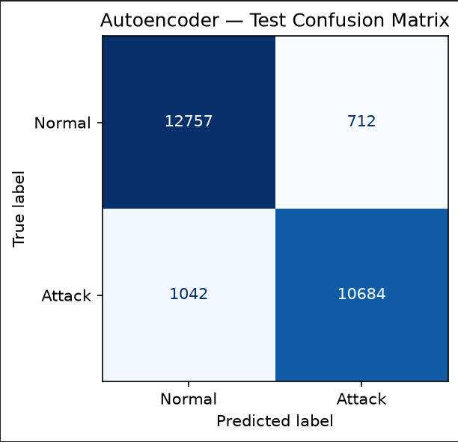
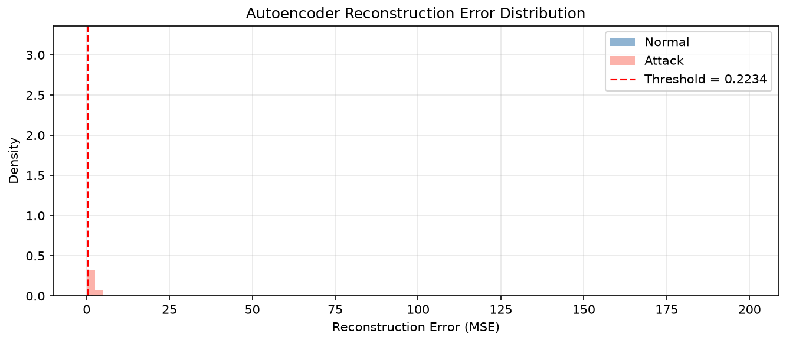
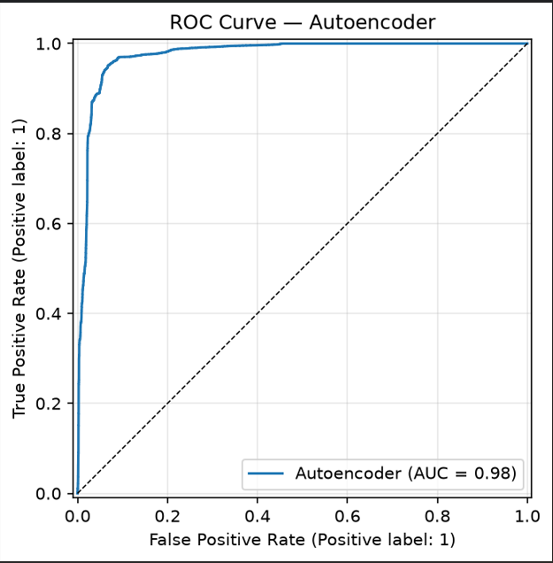
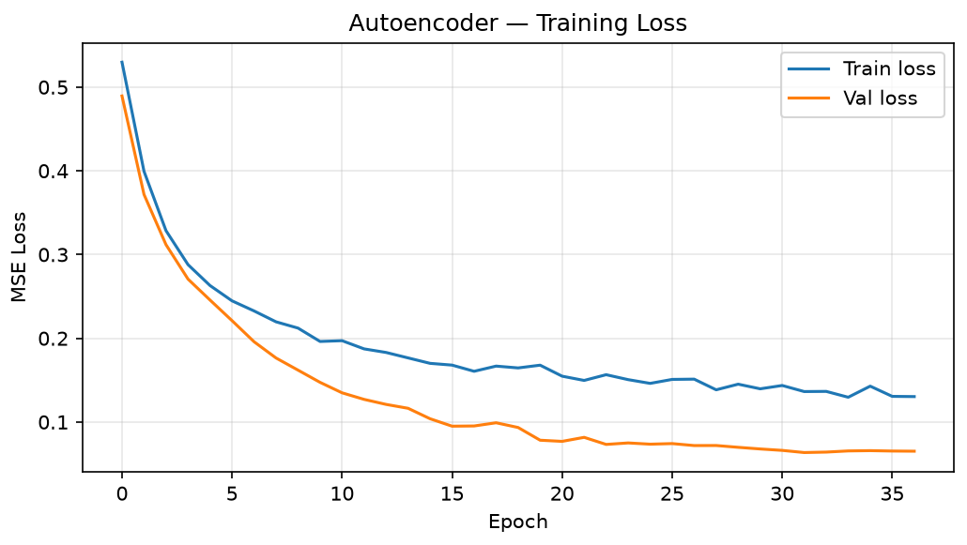
Results and evaluation
Populate the metrics below from the final held-out evaluation—not from a sample upload.
Model
Accuracy
Precision
Recall
F1-score
Evaluation unit
Logistic Regression
[enter]
[enter]
[enter]
[enter]
Flow
LSTM
[enter]
[enter]
[enter]
[enter]
8-flow windows
Autoencoder
N/A*
N/A*
N/A*
N/A*
Anomaly threshold
*For the Autoencoder, report classification metrics only if ground-truth labels and a defined evaluation protocol are used.
RECOMMENDED EVALUATION
DO NOT MIX METRICS
Use a held-out labeled test set; report class balance and confusion matrices.
Live upload attack rates are predictions, not accuracy/precision/recall.
SENTINELFLOW • DDoS ATTACK DETECTION
17

Slide 18
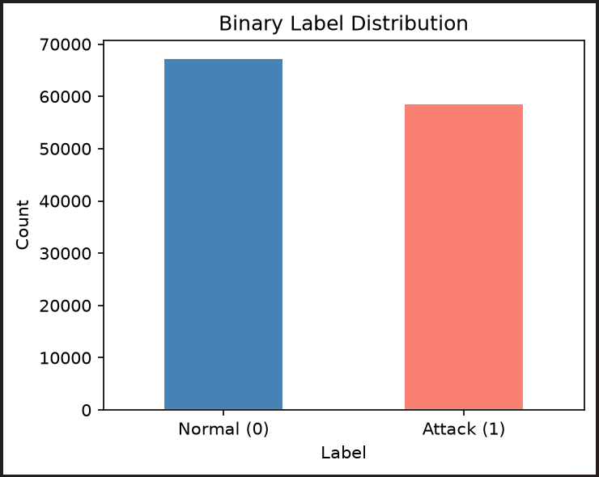
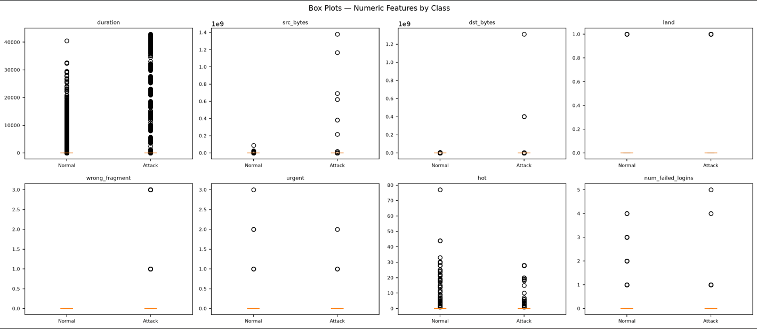
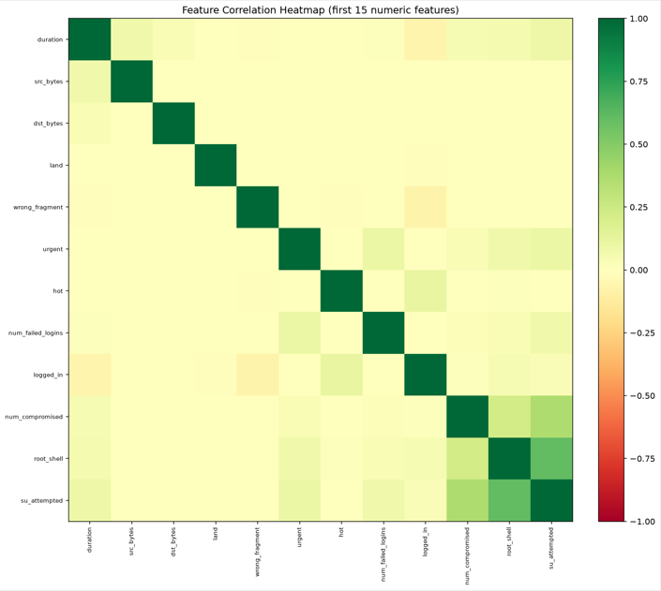
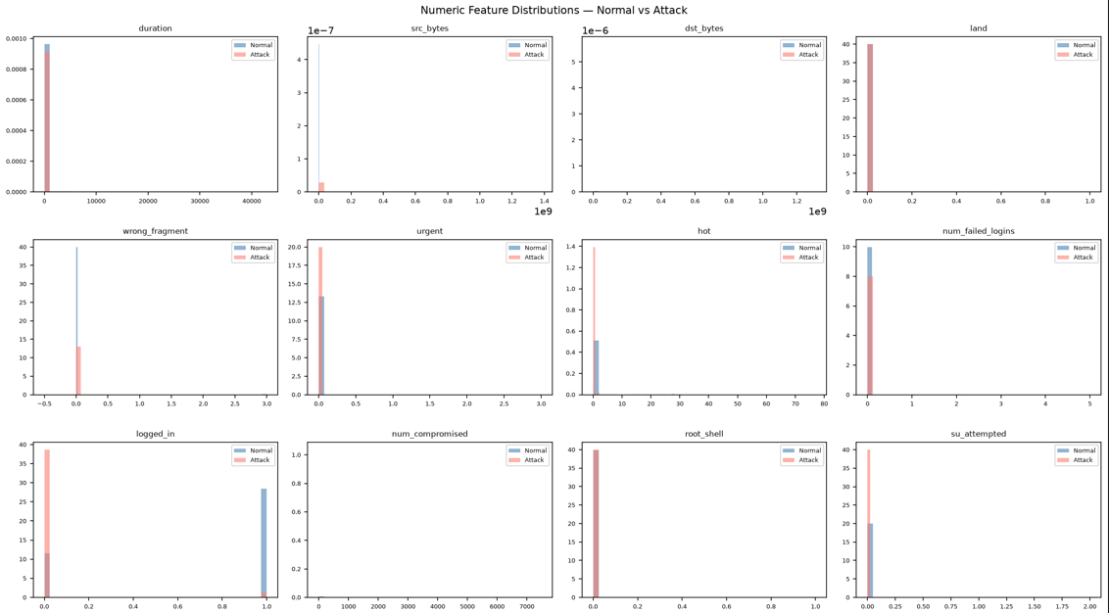
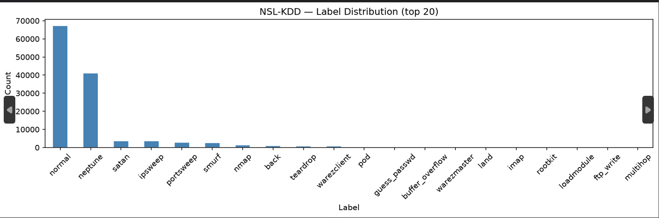
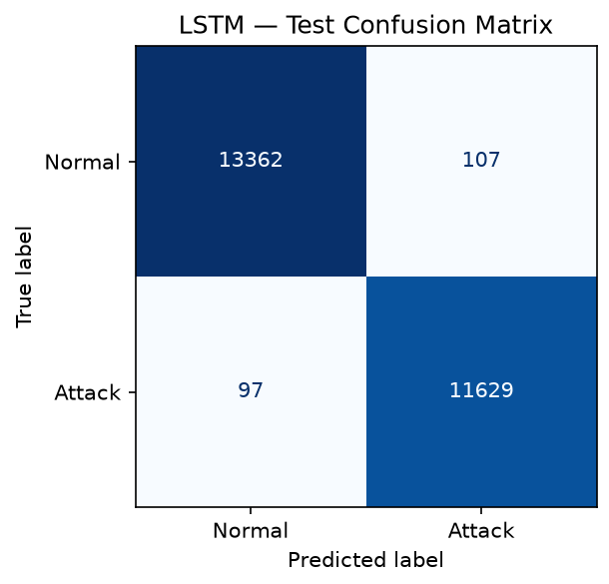

Slide 19
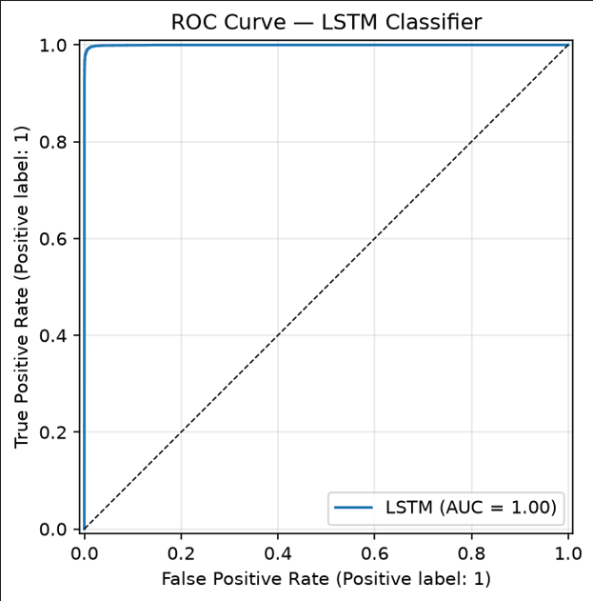
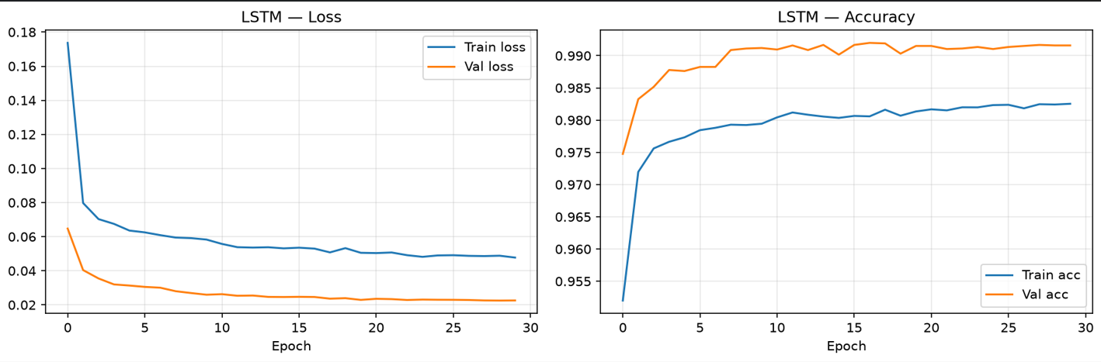
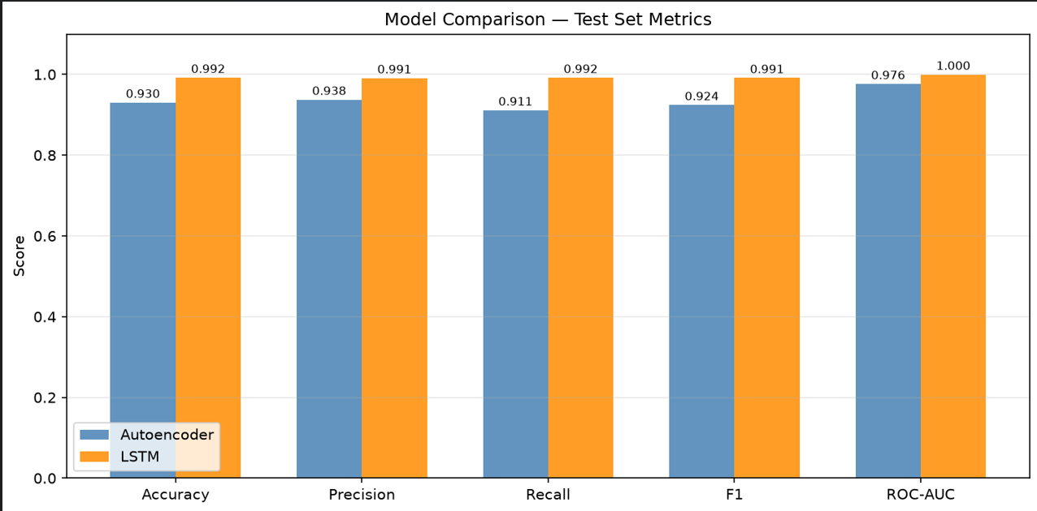

Slide 20
Model comparison and discussion
Complementary strengths and trade-offs.
STRENGTH / ROLE
TRADE-OFF / CAVEAT
Logistic Regression
Fast baseline; per-flow scores
No sequence context
LSTM
Uses ordered 8-flow windows
Needs sufficient ordered rows
Autoencoder
Flags high reconstruction error
Threshold must be validated
Discussion: compare measured test-set results alongside latency, false positives, false negatives, and the number of flows/sequences evaluated.
SENTINELFLOW • DDoS ATTACK DETECTION
18

Slide 21
Training convergence analysis
What should be reported for the neural models.
LSTM
AUTOENCODER
LOGISTIC REGRESSION
Plot training and validation loss by epoch. Look for stable decline and a small generalization gap. A rising validation loss can indicate overfitting.
Plot training and validation reconstruction loss by epoch. Stable convergence should be followed by threshold selection using validation data.
For this model, discuss solver convergence/iteration status rather than neural-network epoch curves.
Important: training-history logs were not supplied with this request, so no convergence curve or claim of convergence is fabricated in this deck.
SENTINELFLOW • DDoS ATTACK DETECTION
19

Slide 22
Limitations and responsible interpretation
Current scope and known constraints.
• The API expects the same 68 trained numerical features; arbitrary CSV schemas are not supported.
• LSTM results depend on row ordering and enough records to form sequence windows.
• The saved anomaly threshold may not generalize to every traffic environment.
• Prediction outputs are not proof of malicious intent and should be validated before operational use.
• The Flask debug server is intended for development, not production deployment.
SAFE DEPLOYMENT NEXT STEPS
• Authentication and access control
• Upload size/rate limits
• Production WSGI server
• Monitoring and audit logs
• Retraining and drift checks
SENTINELFLOW • DDoS ATTACK DETECTION
20

Slide 23
Future scope
Practical next steps to strengthen the prototype.
EVALUATION
DATA + MODEL
DEPLOYMENT
Add a reproducible test protocol, confusion matrices, per-class metrics, ROC/PR curves and latency measurements.
Test on diverse traffic sources, calibrate thresholds, examine class imbalance, and monitor model drift.
Add authentication, safer upload handling, production serving, logging, and optional streaming integration.
SENTINELFLOW • DDoS ATTACK DETECTION
21

Slide 24
Conclusion
A clear, modular prototype for multi-perspective DDoS screening.
• The project connects CSV ingestion, feature validation, preprocessing, model inference, and a web results view.
• Logistic Regression, LSTM, and Autoencoder provide different signals rather than one interchangeable metric.
• Reliable claims about effectiveness require final held-out metrics and a documented evaluation protocol.
• The system provides a foundation for further validation, usability improvements, and safer deployment.
68
required features
8
flows per LSTM window
Thank you • Questions & discussion
SENTINELFLOW • DDoS ATTACK DETECTION
22

Slide 25
SENTINELFLOW
Questions?
DDoS Attack Detection Using LSTM & Autoencoder-Based Anomaly Detection
V. Rohith — 2520090029 • B. Dharshan — 2520090088 • [Guide / Supervisor] • [Department / College]
SENTINELFLOW • DDoS ATTACK DETECTION
23

